Slide 1
Transaction Processing

Slide 2
Transaction Processing Systems
Transaction Processing Systems are the systems with large databases and hundreds of concurrent users executing database transactions.
For example airline reservations, banking, stock markets, etc.

Slide 3
Transaction
A transaction is an executing program that forms a logical unit of database processing.
A transaction includes one or more database access operations- these can include insertion, deletion, modification, or retrieval operations.
Transaction is executed as a single unit. It is a program unit whose execution may or may not change the contents of a database.

Slide 4
Example
A transfer of money from one bank account to another requires two changes to the database both must succeed or fail together.
Subtracting the money from the savings account balance.
Adding the money to the checking account balance.

Slide 5
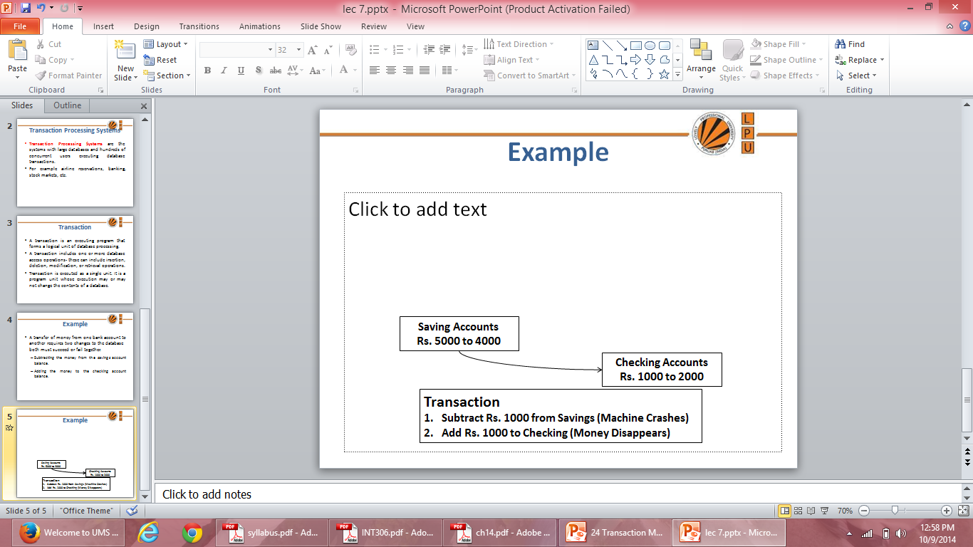
Example

Slide 6
Processes of Transaction
Read Operation: To read a database object, it is first brought into main memory from disk and then its value is copied into a program variable.
A
Read (2)
5000
INPUT (1)
5000 A
a
Physical Block (X)
5000
Program Variable
Main Memory (RAM)
Disk

Slide 7
Processes of Transaction
Write Operation: To write a database object, an in-memory copy of the object is first modified and then written back to disk.
A
Write (1)
5000 to 7000
OUTPUT (2)
5000 to 7000 A
a
Physical Block (X)
7000
Program Variable
Main Memory (RAM)
Disk

Slide 8
Desirable Properties of Transactions
ACID properties:
Atomicity: A transaction is an atomic unit of processing; it is either performed in its entirety or not performed at all.
Consistency preservation: A correct execution of the transaction must take the database from one consistent state to another.
Isolation: A transaction should appear as though it is being executed in isolation from other transactions, even if many transactions are executing concurrently. That is, the execution of a transaction should not be interfered with any other executing transactions.
Durability or permanency: Once a transaction changes the database and the changes are committed, these changes must never be lost because of any failure.

Slide 9
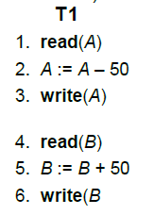
Transaction Properties
Let T1 be a transaction that transfers Rs 50 from account A to account B. This transaction can be defined as:
Say value of A prior to transaction was 1000 and that of B was 2000

Slide 10
Atomicity: Suppose that during the execution of T1, a power failure has occurred that prevented the T1 to complete successfully. The point of failure may be after the completion of Write(A) and before Write(B). It means that the changes in A are performed but not in B. Thus the values of account A and B are Rs.950 and Rs.2000 respectively. We have lost Rs.50 as a result of this failure.
Now, our database is in inconsistent state.
The reason for this inconsistent state is that our transaction is completed partially.
In order to maintain atomicity of transaction, the database system keeps track of the old values of any write and if the transaction does not complete its execution, the old values are restored to make it appear as the transaction never executed.

Slide 11
Consistency: The consistency requirement here is that the sum of A and B must be unchanged by the execution of the transaction. It can be verified easily that, if the database is consistent before an execution of the transaction, the database remains consistent after the execution of the transaction.
Ensuring consistency for an individual transaction is the responsibility of the application programmer who codes the transaction.

Slide 12
Isolation: If several transactions are executed concurrently (or in parallel), then each transaction must behave as if it was executed in isolation. It means that concurrent execution does not result an inconsistent state.
For example, consider another transaction T2, which has to display the sum of account A and B. Then, its result should be Rs.3000.

Slide 13
Transaction Properties
Lets suppose that T1 and T2 perform concurrently, their schedule is shown below:
T1 | T2 | Status
Read (A, a) |  | Value of A i.e. 1000 is copied to local variable a
a: a-50 |  | Local variable a = 950
Write (A, a) |  | Value of local variable a 950 is copied to database item A
 | Read (A, a) | Value of database item A 950 is copied to a
 | Read (B, b) | Value of database item B 2000 is copied to b
 | Display (a+b) | 2950 is displayed as sum of accounts A and B
Read (B, b) |  | Value of data item B 2000 is copied to vocal variable b
b: = b+50 |  | Local variable b = 2050
Write (B, b) |  | Value of local variable b 2050 is copied to database item B

Slide 14
Durability: Once the execution of the transaction completes successfully, and the user who initiated the transaction has been notified that the transfer of funds has taken place, it must be the case that no system failure will result in a loss of data corresponding to this transfer of funds.

Slide 15
Transaction States
Active state– the initial state; the transaction stays in this state while it is executing .
Partially committed state– after the final statement has been executed.
Failed state -- after the discovery that normal execution can no longer proceed.
Aborted state– after the transaction has been rolled back and the database restored to its state prior to the start of the transaction. Two options after it has been aborted:
restart the transaction can be done only if no internal logical error
kill the transaction
Committed state – after successful completion

Slide 16
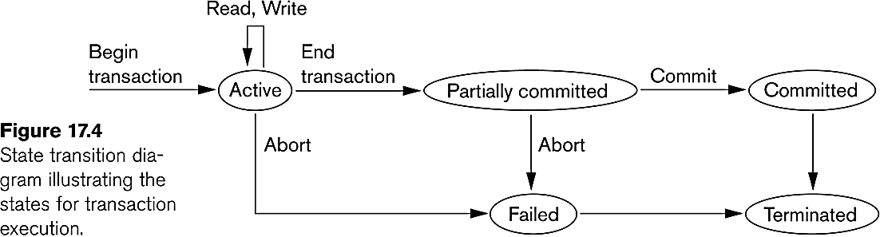
State Transition Diagram

Slide 17
Concurrent Executions
Multiple transactions are allowed to run concurrently in the system.
Advantages are:
increased processor and disk utilization, leading to better transaction throughput
E.g. one transaction can be using the CPU while another is reading from or writing to the disk
reduced average response time for transactions: short transactions need not wait behind long ones.
Concurrency control schemes – mechanisms to achieve isolation that is, to control the interaction among the concurrent transactions in order to prevent them from destroying the consistency of the database

Slide 18
Why Concurrency Control is needed?
The Lost Update Problem
This occurs when two transactions that access the same database items have their operations interleaved in a way that makes the value of some database item incorrect.
The Temporary Update (or Dirty Read) Problem
This occurs when one transaction updates a database item and then the transaction fails for some reason
The updated item is accessed by another transaction before it is changed back to its original value.
The Incorrect Summary Problem
If one transaction is calculating an aggregate summary function on a number of records while other transactions are updating some of these records, the aggregate function may calculate some values before they are updated and others after they are updated.

Slide 19
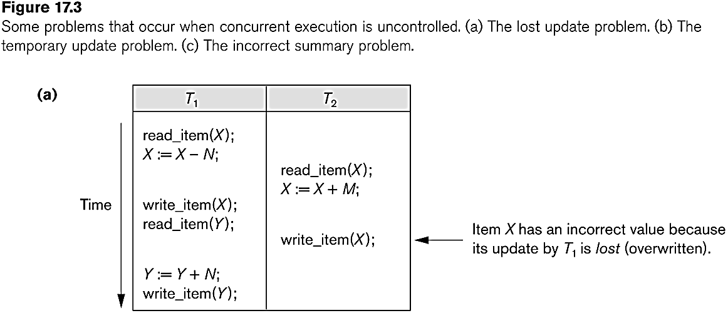
Concurrent execution is uncontrolled: (a) The lost update problem.

Slide 20
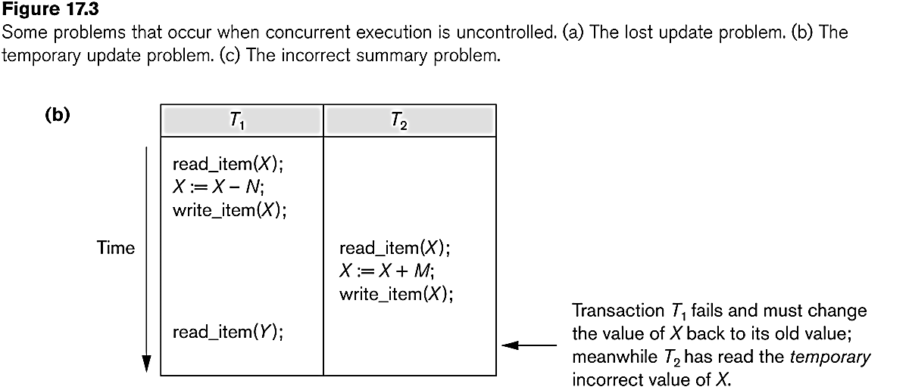
Concurrent execution is uncontrolled: (b) The temporary update problem.

Slide 21
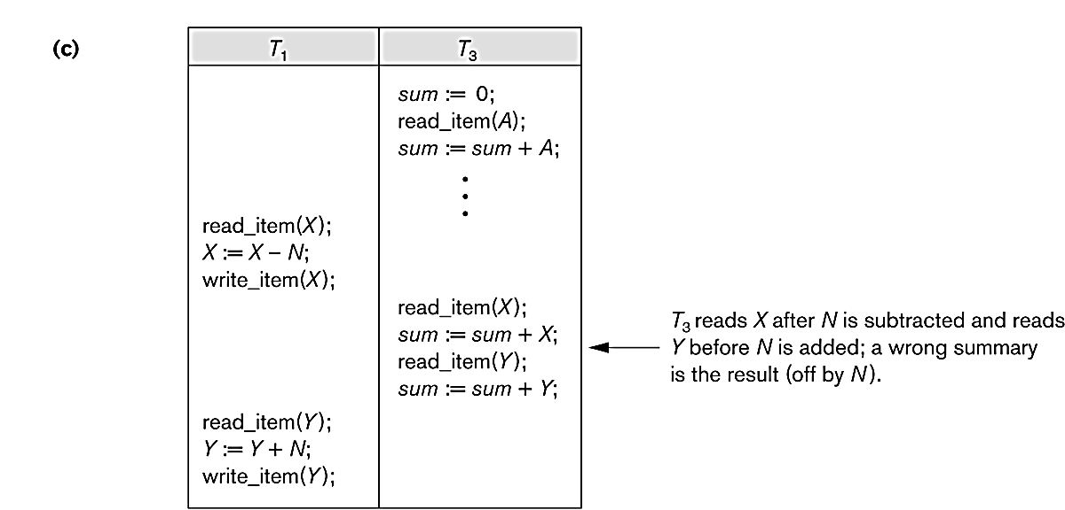
Concurrent execution is uncontrolled: (c) The incorrect summary problem.

Slide 22
Schedules
Schedule – a sequences of instructions that specify the chronological order in which instructions of concurrent transactions are executed
a schedule for a set of transactions must consist of all instructions of those transactions
must preserve the order in which the instructions appear in each individual transaction.
A transaction that successfully completes its execution will have a commit instructions as the last statement
by default transaction assumed to execute commit instruction as its last step
A transaction that fails to successfully complete its execution will have an abort instruction as the last statement

Slide 23
Scheduling of Transactions
Complete Schedule: A schedule that contains either an abort or a commit for each transaction whose actions are listed in it is called a complete schedule.
Serial Schedule: Each serial schedule consists of a sequence of instructions from various transactions, where the instructions belonging to one single transaction appear together in that schedule. If the actions of different transactions are not interleaved, we call that schedule a serial schedule.

Slide 24
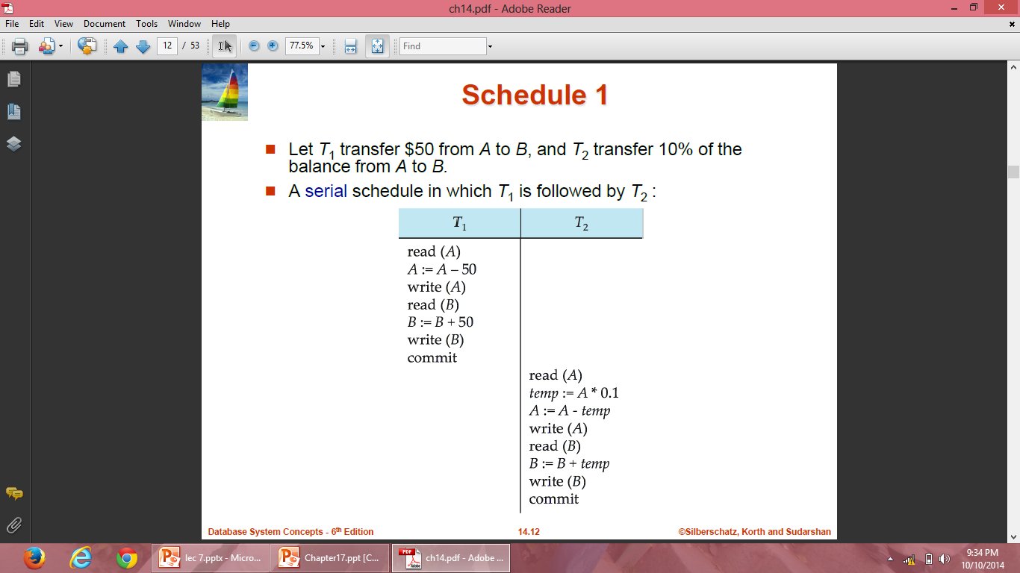
Schedule 1

Slide 25
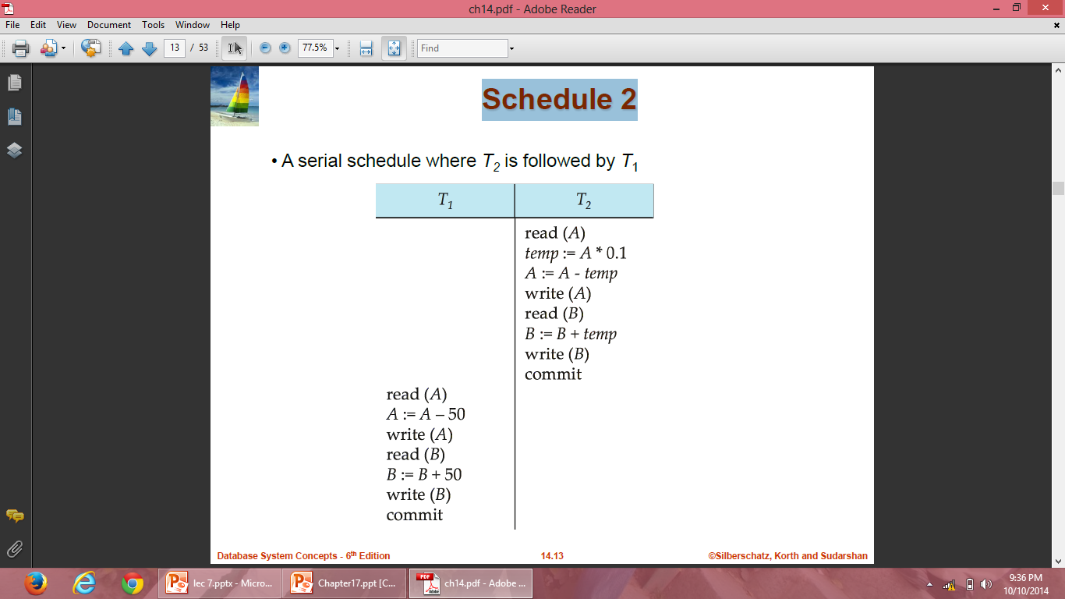
Schedule 2

Slide 26
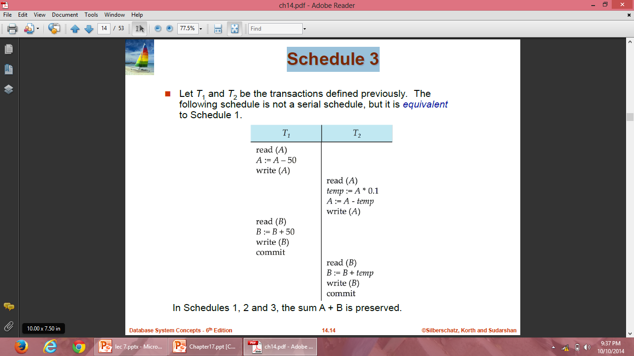
Schedule 3

Slide 27
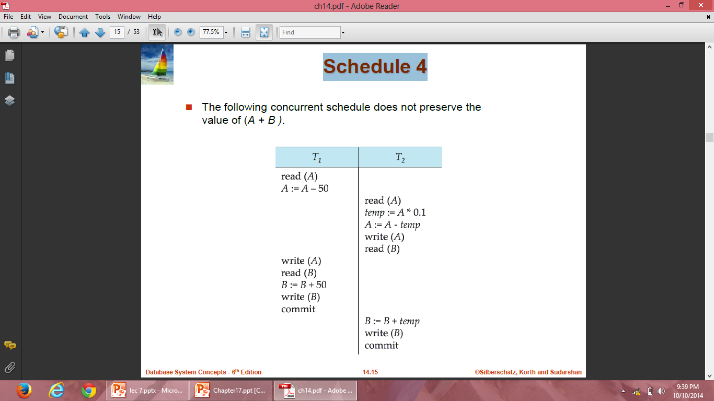
Schedule 4

Slide 28
Scheduling of Transactions
Serializiable Schedule: A non-serial schedule that is equivalent to some serial execution of transactions is called a serializiable schedule.
For example schedule-3 is serializable schedule, which is equivalent to schedule-1 and schedule-2.
The objective of serializability is to find non-serial schedules that allow transactions to execute concurrently without interfering with one another, and thereby produce a database state that could be produced by a serial execution.

Slide 29
Serializability
Basic Assumption – Each transaction preserves database consistency.
Thus serial execution of a set of transactions preserves database consistency.
A (possibly concurrent) schedule is serializable if it is equivalent to a serial schedule. Different forms of schedule equivalence give rise to the notions of:
1. conflict serializability
2. view serializability

Slide 30
Conflict Serializability
If a schedule S can be transformed into a schedule S’ by a series of swaps of non-conflicting instructions, we say that S and S’ are conflict equivalent.
We say that a schedule S is conflict serializable if it is conflict equivalent to a serial schedule.

Slide 31
Conflict Serializability
We need to check the conflicts between two consecutive operations of two different transactions in a schedule. Operations upon data can be read or write. There are two possibilities:
If two consecutive operations are on different data items, then they donot conflict i.e, their order of execution does not matter and we can swap them without affecting their result.
If two consecutive operations are on same data items, then they can conflict i.e their order of execution matters and we cannot swap them.

Slide 32
Conflict Serializability
Consider a schedule S in which there are two consecutive operations Oi and Oj of two transactions Ti and Tj and both operations refer to the same data item A. Then, there are following four cases:
Oi= read(A) and Oj= read(A). Then, their order does not matter because same value of A is read by Ti and Tj.
Oi= read(A) and Oj= write(A). Then, their order matters. If Oi comes before Oj then, Oj does not read the value of A written by Oi. If Oj comes before Oi then, Oi reads the value of A that is written by Oj.
Oi= write(A) and Oj= read(A). Then, their order matters. If Oi comes before Oj then, Oj reads the value of A written by Oi. If Oj comes before Oi then, Oj does not read the value of A that is written by Oi.
Oi= write(A) and Oj= write(A). Then, their order matters. If Oi comes after Oj then, the value of A written by Oi is stored in database. If Oj comes after Oi then, the value of A written by Oj is stored in database.

Slide 33
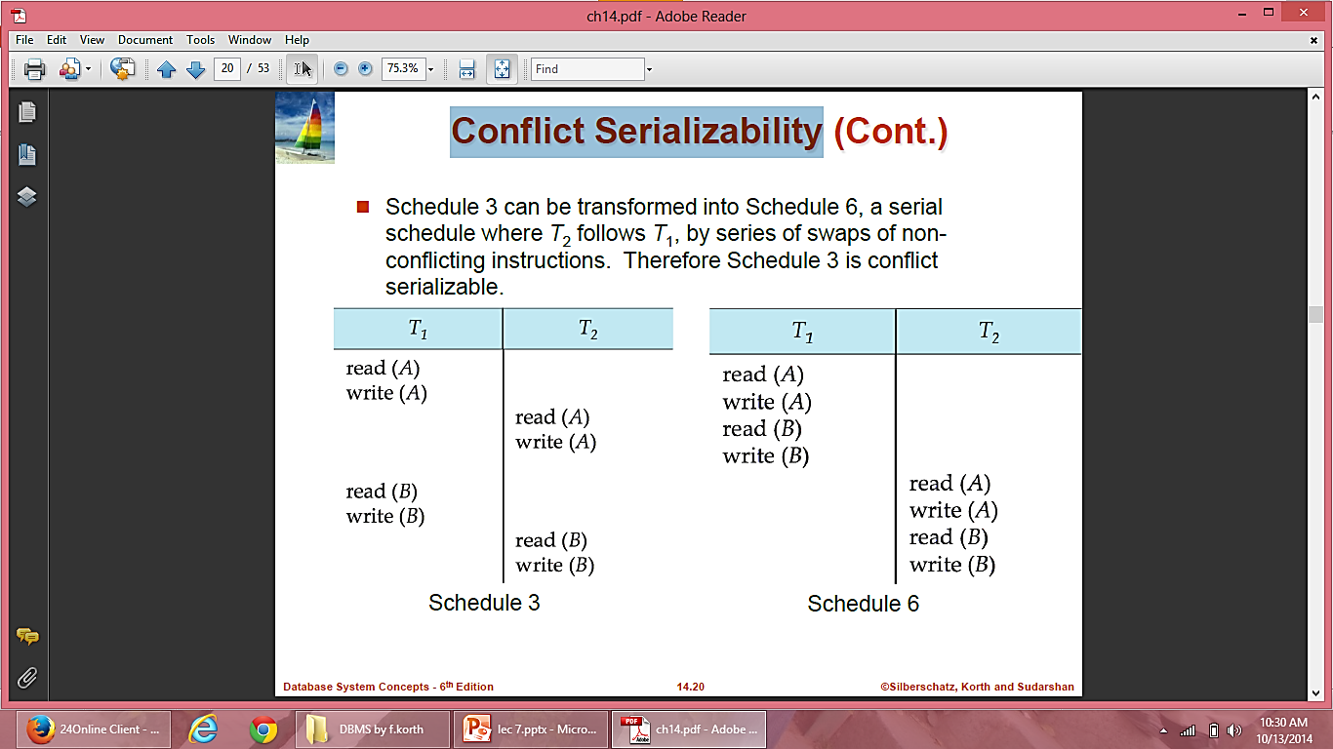
Conflict Serializability

Slide 34
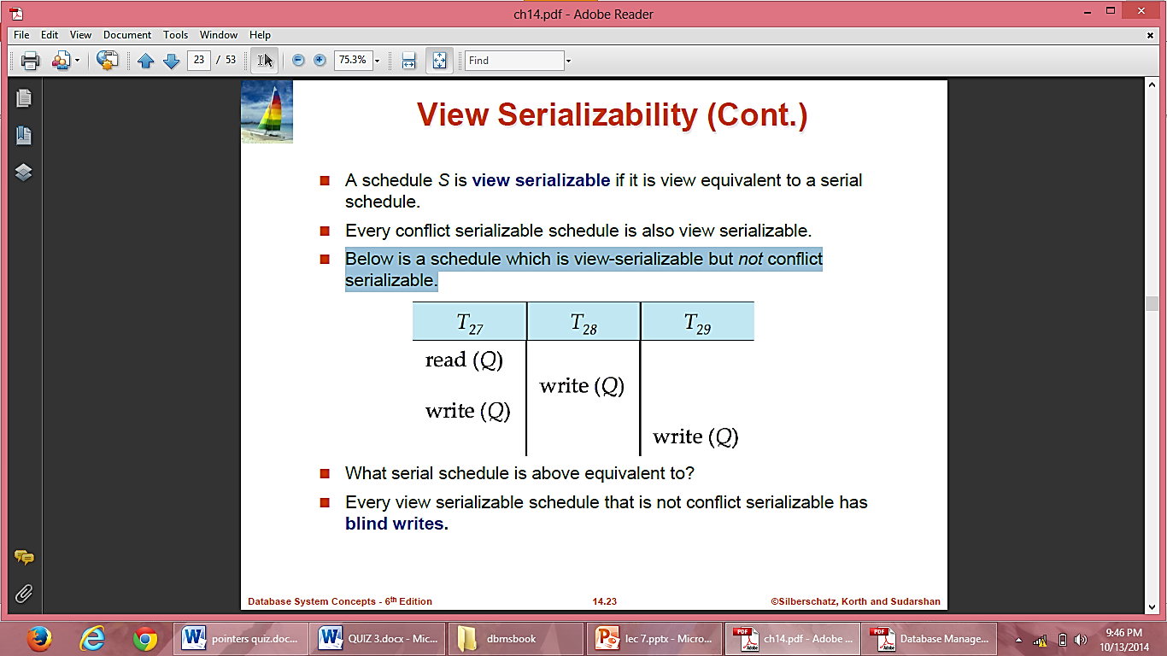
View Serializability
A schedule is said to be view-serializable if it is view-equivalent to some serial schedule.
Any schedule that is conflict-serializable is also view-serializable, but not vice versa.
Below is a schedule which is view-serializable but not conflict serializable.
Every view serializable schedule that is not conflict serializable has blind writes.

Slide 35
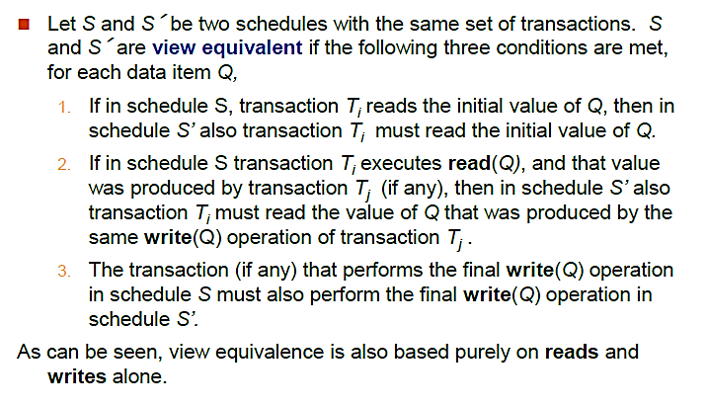
View Serializability

Slide 36
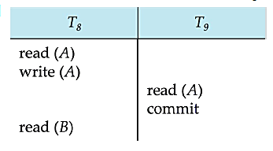
Recoverable Schedules
Need to address the effect of transaction failures on concurrently running transactions.
Recoverable schedule — if a transaction Tj reads a data item previously written by a transaction Ti , then the commit operation of Ti appears before the commit operation of Tj.
The following schedule is not recoverable if T9 commits immediately after the read
If T8 should abort, T9 would have read an inconsistent database state. Hence, database must ensure that schedules are recoverable.

Slide 37
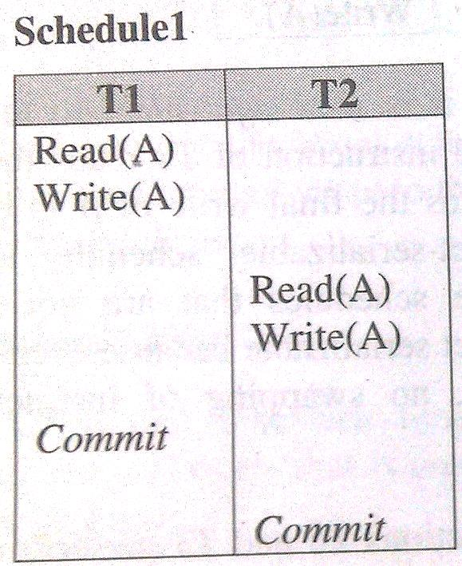
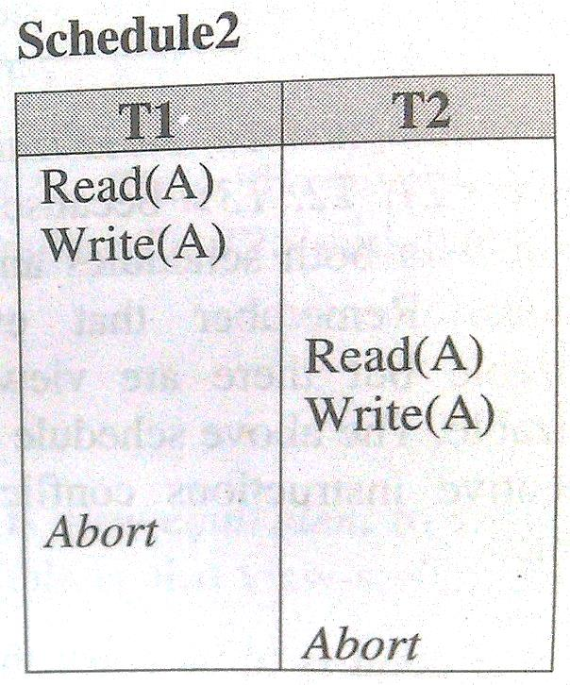
Recoverable Schedules
A schedule is said to be recoverable, if for each pair of transaction Ti and Tj such that Tj reads a data item previously written by Ti, the commit operation of Ti appears before the commit operation of Tj.
Both the above schedules are recoverable .

Slide 38
Recoverable Schedules
Schedule1 is recoverable because T2 reads the value of A updated by T1 and also T1 commits before T2 which makes the value read by T2 correct. Then T2 can commit itself.
In schedule2, if T1 is aborted, T2 has to abort because the value A it read is incorrect.
In both cases, the database is in consistent state.

Slide 39
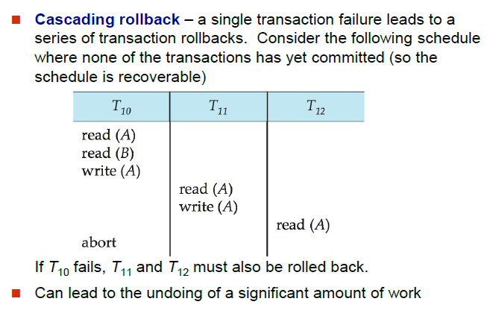
Cascading Rollbacks

Slide 40
Cascadeless Schedules
Cascadeless schedules—cascading rollbacks cannot occur; for each pair of transactions Ti and Tj such that Tj reads a data item previously written by Ti, the commit operation of Ti appears before the read operation of Tj.
Every cascadeless schedule is also recoverable

